Slide 1



DefendAI - A Cyber Security AI Assistant
Team Name : CyberSafe
By : Sarita Sangrez
Fatima Naeem
Rumaisah Haroon
Amna Ali
Date : 28th April 2025
1

Slide 2

Problem & Urgency
2023: Over 17 billion personal records exposed in data breaches (Flashpoint)
Digital footprints are scattered across social media, cloud, and dark web
Users lack tools to detect leaks before it's too late
They tend to be reactive, not preventive
2

Slide 3
AI Solution Overview
DefendAI monitors digital footprints, detects breaches, and guides response
AI scans websites, social media, and dark web in real time
Clear alerts and custom advice—no cybersecurity expertise needed
3

Slide 4
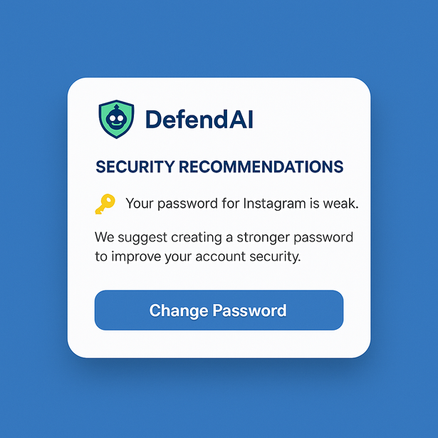
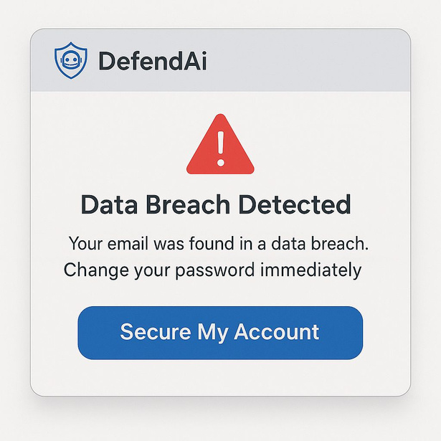
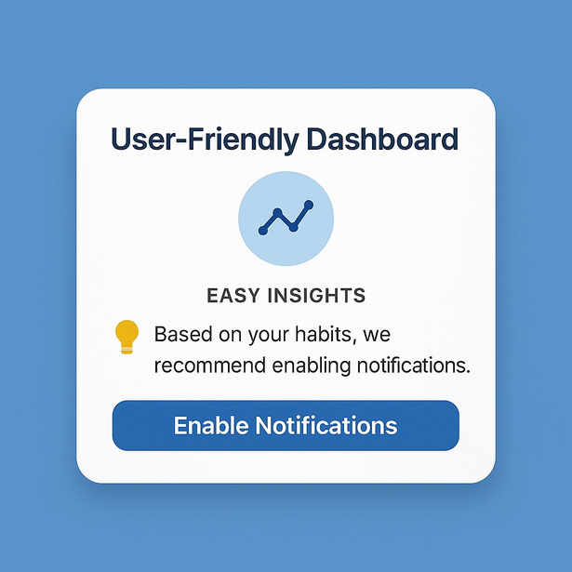
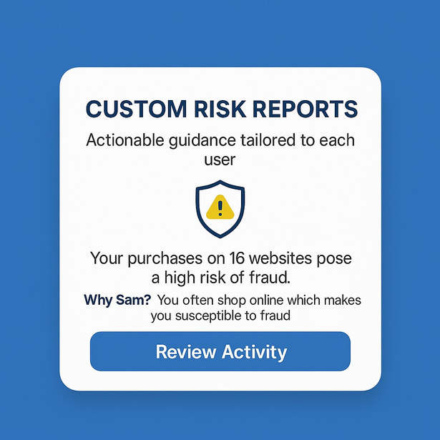
How DefendAI Works
4

Slide 5
How DefendAI Works
USER INPUT
.
DEFEND AI BOT
DETECT
ANALYZE
ALERT
DATA PHISHING
DARK WEB THREATS
REAL TIME ALERTS
DIGITAL TRACKING
SECURITY REPORTS
DATA BREACHES
5

Slide 6

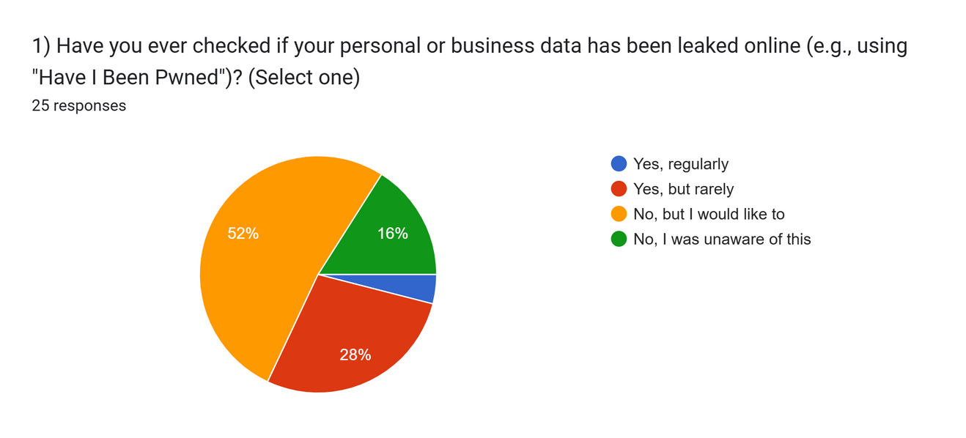

Need Analysis
Rising Cyber Threats and DefendAI's Role
Rising Cyber Threats: Increased data breaches, identity theft, and exposed digital footprints.
Why DefendAI?
Survey results show a
strong need for
Proactive Monitoring
Phishing Protection
User Awareness
6

Slide 7


Need Analysis
Market Demand and Need for Simpler Solutions
Growing Cybersecurity Concerns: More personal and financial tasks are online, increasing risks.
Regulatory Pressure: GDPR and data protection laws are pushing for better privacy solutions.
Need for Simplicity: Current cybersecurity tools are complex; users need an accessible, easy-to-use solution.
7

Slide 8




Target Users
Non-tech-savvy employee: Needs simple alerts and peace of mind
Small business owner: Needs to protect customer data without an IT team
IT Manager: Needs accurate, fast threat response to internal risks
8

Slide 9





Key Features
Digital Footprint Scanner: Tracks leaks across internet and dark web
Real-Time Alerts: Instantly warns of breaches or suspicious activity
Behavior-Based Detection: Identifies anomalies in online behavior
User-Friendly Dashboard: Easy insights, proactive tips
Custom Risk Reports: Actionable guidance tailored to each user
Security Recommendations: Provides actionable advice like strengthening passwords, updating software, and enabling two-factor authentication.
9

Slide 10
Competitive Advantage
Tool | Target Users | Key Limitations | How DefendAI Stands Out
Norton Genie | Individuals, Small Businesses | Focuses only on phishing; no dark web or footprint analysis | Tracks full digital footprint, dark web, sends smart alerts
IBM Watson | Enterprises, SOC Analysts | Complex, high-cost, not suitable for everyday users | Simple, affordable, tailored for non-tech users
Microsoft Defender | Microsoft 365, IT Teams | Tied to Microsoft, lacks cross-platform support | Works across platforms with personalized, user-friendly tips
10

Slide 11
IMPLEMENTATION AND ETHICS
ROADMAP
ETHICAL CONSIDERATIONS
Phase 1 - Research & Planning: Identify user needs, legal standards (GDPR), ethical risks
Phase 2 - MVP Development: Build digital footprint scanner, alert system
Phase 3 - Beta Testing: User testing with real-time feedback and improvements
Phase 4 - Full Launch: Marketing, partnerships, continuous monitoring
Privacy: All data scanned stays private and encrypted
Bias Mitigation: AI trained on diverse datasets to reduce false positives
Transparency: Users are informed when and how their data is analyzed
Consent: User control over what data is scanned
11

Slide 12
Summary
DefendAI is an AI-powered tool that monitors and protects users' digital footprints.
Provides real-time alerts and includes phishing detection.
Monitors the dark web for data leaks and breaches.
Ensures privacy and security for users' personal data.
Focuses on ease of use and accuracy.
Offers a reliable solution for safeguarding personal data online.
12

Slide 13
Call To Action
Your feedback fuels our next steps
Support our mission to make cybersecurity accessible
We’re open to partnerships and and collaborations
Join us—test, invest, or support a safer digital world
Stay one step ahead of the hackers, because in the digital world, it's better to defend than to regret!
13

Slide 14
Thank you!
Feel Free to Ask Questions.
Your privacy isn’t optional. It’s essential.
14

